Slide 1


WASEDA University
Graduate School of Information, Production and Systems
Research progress
Presented by:
Ma Jiaji
Iwaihara Lab, IPS, Waseda Univ.

Slide 2
Contents
Dataset
Algorithm
Ideas
Future work

Slide 3
Dataset
 | Leaf vegetables |  | Crocodylidae |  | Chameleons |  | Squirrels
 | Nodes | Edges | Nodes | Edges | Nodes | Edges | Nodes | Edges
Jan. 1 | 779 | 15785 | 2753 | 82419 | 1448 | 11724 | 2885 | 64847
Jan. 20 | 779 | 15916 | 2753 | 82682 | 1448 | 11775 | 2885 | 64788
Feb. 1 | 779 | 15918 | 2753 | 82453 | 1448 | 11784 | 2885 | 64830
Feb. 20 | 779 | 15923 | 2753 | 81995 | 1448 | 11735 | 2885 | 64903
Mar. 1 | 779 | 15929 | 2753 | 82017 | 1448 | 11739 | 2885 | 65127
Apr. 1 | 779 | 15838 | 2753 | 82034 | 1448 | 11727 | 2885 | 65137
Apr. 20 | 779 | 15262 | 2753 | 79090 | 1448 | 10800 | 2885 | 64216
May 1 | 779 | 15107 | 2753 | 78517 | 1448 | 10621 | 2885 | 64000
May 20 | 779 | 14999 | 2753 | 78339 | 1448 | 10591 | 2885 | 64153

Slide 4

Dataset
Problems in extracting page title and category:
1. Some pages’ title are not English word or invisible word
2. In each timestamp, category file is about 70G, so extract from 10 files need a lot time.
3. Some pages are redirect pages which are not have category information.

Slide 5
Algorithm
Static graph embedding：
DeepWalk
Node2vec
LINE
SDNE
Dynamic graph embedding：
Triadic closure
CTDNE
DynGEM

Slide 6
Algorithm
SDNE:
Generate graph adjacency matrix A and Laplacian matrix L.
Build neural network, the input is [A, L] with several fully connect layers, the middle layer’s output treated as Y, and the end of network output is A’, the loss function is between [A, L] and [A’,Y]
After training, Y is the each node representation vector.
Reference:
Wang, D., Cui, P., & Zhu, W. (2016, August). Structural deep network embedding. In Proceedings of the 22nd ACM SIGKDD international conference on Knowledge discovery and data mining (pp. 1225-1234).

Slide 7
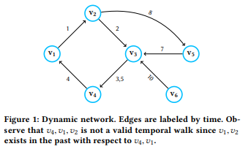
Algorithm
CTDNE:
Edges must be traversed in increasing order of edge times.
Initial temporal edge selection and next neighbor selection: Unbiased, Exponential, Linear
Different with Deepwalk, CTDNE use max context windows number to stop randomwalk
Reference:
Nguyen, G. H., Lee, J. B., Rossi, R. A., Ahmed, N. K., Koh, E., & Kim, S. (2018, April). Continuous-time dynamic network embeddings. In Companion Proceedings of the The Web Conference 2018 (pp. 969-976).

Slide 8
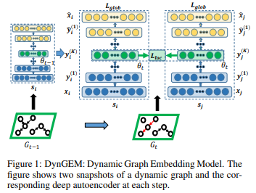
Algorithm
DynGEM:
This model is especially designed for node number increase temporal graph.
The input and output are the same adjacency matrix, Overall framework is adjacency matrix -> encoder -> embedding vector -> decoder -> adjacency matrix
Next snapshot, append a larger layer at the beginning and end.
Reference:
Goyal, P., Kamra, N., He, X., & Liu, Y. (2018). Dyngem: Deep embedding method for dynamic graphs. arXiv preprint arXiv:1805.11273.

Slide 9
Ideas
Random walk: next node’s selection must obey time and selection bias is related with common categories.
obey time: Each link has a timestamp, and next link must equal or larger than previous link.
bias with common categories: if one of current node’s neighbor has more common categories with the current node, it will have more probably to walk to this neighbor node.
Use title sequence to replace traditional node sequence. Get each word representation, and combine each word vector to get the title vector (node vector).

Slide 10
Ideas
Random walk: next node’s selection must obey time and selection bias is related with title representation and common categories.
title representation and common categories: use one-hot encoding to get each title representation, so we could calculate the similarity of each title and defined similarity score as x. Based on common categories, we could calculate the each node pair’s common categories score and defined as y. so, add the weight of this two scores and define αx+βy as selection bias.
Use bias to generate walks and skip-gram get node vector.

Slide 11
Future work
Dataset:
Consider a more reasonable way to select node (dealing with page title and redirect page)
Consider a more reasonable way to deal with 70G category information file.
Model:
After finish dataset, do experiments about previous ideas and compare the results with CTDNE and node2vec.
Read paper about DynLink2Vec and DDNE algorithm.

